Slide 1
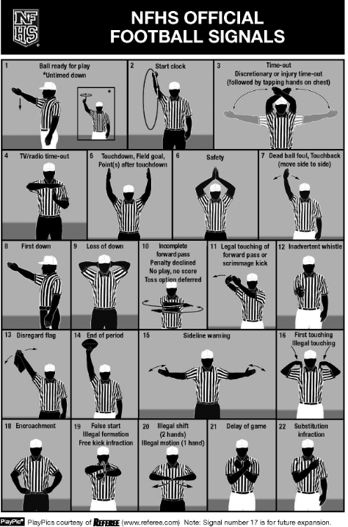
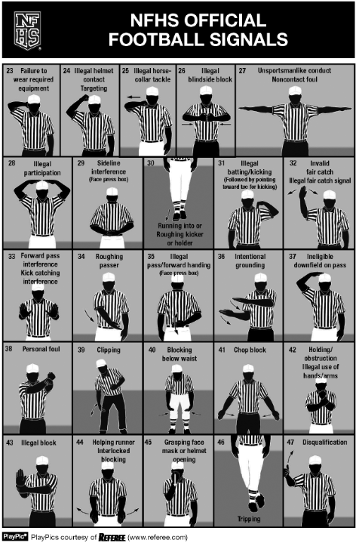
The Central Kentucky Football Officials Association(CKFOA) Officials for tonight's game : Referee: _______ Umpire: _ ____________Head Linesman: _______________ Line Judge: _______ Back Judge:__________________

